Slide 1
iChat Application
This application is made by a some programming languaes like that.
HMTL
CSS
NODE.JS
JAVASCRIPT
This application similar to a whats’app chat application send to message to another person and receive the message and communicate the one to another person with help of this chat application. And connect the one time a multiple users on this application.
Today every person is connect to the social media and Mobile and use on every online chat video call, game ,twitter, etc online mobile application and find out world latest news or enjoy on yourself life. This Realtime chat application is very helpful all person of enjoy and talk to another person ,use on a family member or friends.

Slide 2
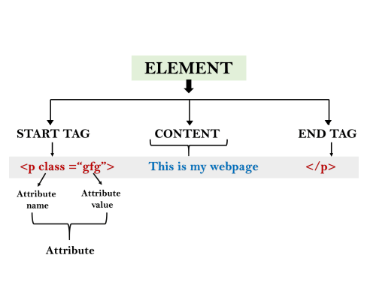
HTML
HTML is a markup language that web browsers use to interpret and compose text, images, and other material into visual or audible web pages. Default characteristics for every item of HTML markup are defined in the browser, and these characteristics can be altered or enhanced by the web page designer's additional use of CSS.
HTML is used to create electronic documents (called pages) that are displayed on the World Wide Web. Each page contains a series of connections to other pages called hyperlinks. Every web page you see was written using one version of HTML. HTML code ensures the proper formatting of text and images for your Internet browser.

Slide 3
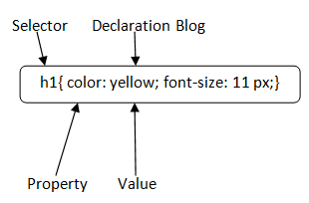
css
CSS stands for Cascading Style Sheets. It is a style sheet language which is used to describe the look and formatting of a document written in markup language. It provides an additional feature to HTML. It is generally used with HTML to change the style of web pages and user interfaces. It can also be used with any kind of XML documents including plain XML, SVG and XUL.
CSS is used along with HTML and JavaScript in most websites to create user interfaces for web applications and user interfaces for many mobile applications.
You can add new looks to your old HTML documents.
You can completely change the look of your website with only a few changes in CSS code.

Slide 4
javascript
JavaScript is a scripting language for creating dynamic web page content. It creates elements for improving site visitors’ interaction with web pages, such as dropdown menus, animated graphics, and dynamic background colors.
The initial versions of the scripting language were for internal use only. After Netscape submitted it to ECMA International as a standard specification for web browsers, JavaScript pioneered the release of ECMAScript.
It was a general-purpose scripting language to ensure web pages’ interoperability across different browsers and devices.
Today, JavaScript has plenty of frameworks and libraries to simplify complex projects, such as AngularJS, jQuery, and ReactJS.
Originally run on the client-side, the JavaScript implementation has branched out to the server-side after the Node.js
JavaScript is a lightweight,interpreted programming language.
Designed for creating network-centric applications.
Complementary to and integrated with Java.
Complementary to and integrated with HTML.
Open and cross-platform
USE
1. Web and Mobile Apps
2. Building Web Servers and Server Applications
3. Interactive Behavior on Websites
4. Game Development

Slide 5
NODE.JS
Node.js is an open source server environment.
Node.js allows you to run JavaScript on the server.
Node.js is an open source server environment
Node.js is free
Node.js runs on various platforms (Windows, Linux, Unix, Mac OS X, etc.)
Node.js uses JavaScript on the server
Node.js can generate dynamic page content
Node.js can create, open, read, write, delete, and close files on the server
Node.js can collect form data
Node.js can add, delete, modify data in your database
Node.js uses asynchronous programming!

Slide 6
Web Socket
WebSocket technology is at the forefront of real-time applications such as chat services, financial data streaming, and multiplayer games. In the era of blockchain, WebSockets represent a crucial set of tools for building Web3 applications and dApps. Read on to learn what WebSocket is, how the protocol works, and why it makes sense for developer platforms like Moralis to fully support WebSocket APIs. If you’ve kept an eye on Moralis, you will know that Moralis Speedy Nodes recently launched full support for WebSockets!
Is socket Io a WebSocket implementation?
Socket.IO is NOT a WebSocket implementation. Although Socket.IO indeed uses WebSocket as a transport when possible, it adds additional metadata to each packet. That is why a WebSocket client will not be able to successfully connect to a Socket.IO server, and a Socket.IO client will not be able to connect to a plain WebSocket server either.
Key features of WebSocket : WebSocket helps in real-time communication between the Client and the web server. This protocol helps in transforming to cross-platform in a real time world between the server and the client. This also enables the business around the world for real-time web application to enhance and to increase the feasibility.

Slide 7
Node.js Socket.io
Earlier, websites used to reload every-time a resource was requested. This introduced unnecessary delays which increased average wait time. Often users had to wait for minutes to fetch a particular page or file. Real-time applications(Instant messenger, Online gaming, push notification etc), on the other hand, are those applications which run within a given time-slot such that user is presented with immediate and up-to-date copy of the resource. Latency in these applications is kept as low as possible to give smooth and consistent user experience. Socket.IO is one such JavaScript library that programmers use in developing real-time “Web Applications”.
Server: To install it in the Node.js project, run the following command,
JavaScript Client: A standalone build of the client is exposed by default by the server at /socket.io/socket.io.js. Otherwise, it can also be served from any of the CDN providers.To use it from Node.js, install it via this command,

